Slide 1
Circular Queue for Passenger Boarding
Circular Bus/Train Queue Management System Using Circular Queue
SOHAM RANE D7B 39
Problem
Objectives
Passengers wait to board a bus or train in strict arrival order. Storage freed by boarded passengers must be reused efficiently.
  Add and board passengers in FIFO order, each in O(1)
  Reuse freed slots by wraparound in a 5-slot array
  Report overflow and underflow without crashing
  Search by ticket and show queue status and history
User
A transport counter operator using a console menu.
101
102
103
empty
empty
Boarding →
Notes:
Intro (Member 1): state the problem and the user. Only the array Passenger[] with front, rear, size, capacity is the queue; no java.util Queue or LinkedList is used for it. Initial data: tickets 101 Aarav Thane, 102 Meera Dadar, 103 Rohan Panvel; next ticket is 104. Replace the team placeholder with real names and roll numbers. Confirm the boarding-history implementation (manual array or otherwise) before presenting; describe only what is actually built.
1

Slide 2
Why a Circular Queue Fits Boarding
FIFO queue in a ring
States and overflow
First passenger in is first boarded. The array is treated as a ring: after index 4 comes index 0.
Empty: size == 0
Full: size == capacity
A size counter avoids the front == rear ambiguity.
Stored: ticket number, name, destination per passenger; plus queue[], front, rear, size, capacity = 5.
If full, add is refused and an overflow message is shown; no passenger is overwritten.
Aspect | Linear array queue | Circular queue (ours) | Linked-list queue
Freed slots | Wasted after dequeue | Reused by wraparound | Nodes freed
Memory | Fixed | Fixed, O(C) | Grows, pointer overhead
Enqueue / dequeue | O(1), but fills up early | O(1) | O(1)
Overflow | Even with free space | Only when size = capacity | Only when memory ends
Notes:
Member 2: explain FIFO and why boarding is naturally FIFO. A linear array queue moves front forward and never reuses the freed cells, so it reports full after capacity insertions overall. A linked list avoids that but adds node allocation and pointers, which is unnecessary for a small fixed counter queue. With front/rear alone, an empty and a full ring look alike; the size counter resolves this.
2

Slide 3
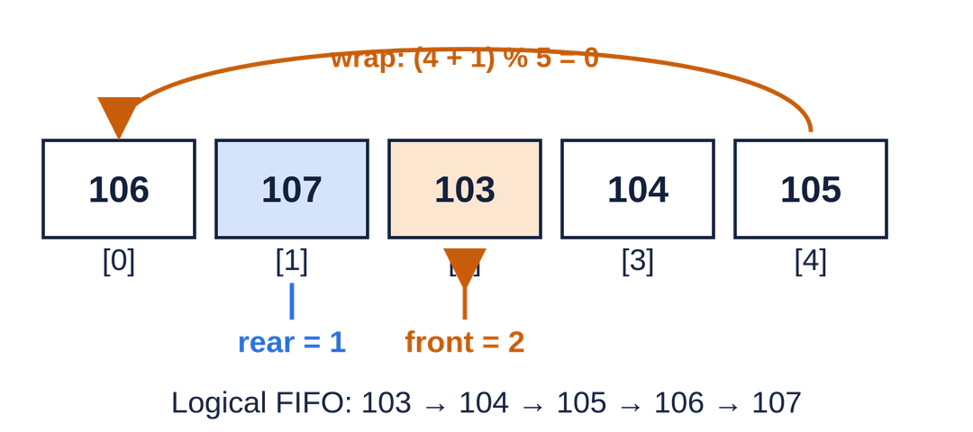
Array Structure and Core Algorithms
PSEUDOCODE: enqueue(p)
1. if size == capacity: overflow
2. rear = (rear + 1) % capacity
3. queue[rear] = p
4. size = size + 1
PSEUDOCODE: dequeue()
1. if size == 0: underflow
2. p = queue[front]
3. queue[front] = null (if done)
4. front = (front + 1) % capacity
5. size = size - 1
6. return p
Physical order (index 0 to 4) differs from logical order (front onward, wrapping). Shown: final state of the dry run.
Notes:
Member 3 explains the diagram and enqueue; Member 4 explains dequeue. Algorithms are pseudocode, not Java. LIVE DEMO PLAN: 1) javac TransportQueueSystem.java then java TransportQueueSystem. 2) Display initial queue (101-103). 3) Add passengers until full (104, 105). 4) Try one more add to show overflow. 5) Board a passenger to free a slot. 6) Add another passenger to show wraparound. 7) Search a ticket and display queue status. If short on time: do enqueue, dequeue, wraparound and one boundary case. Use real terminal output only.
3

Slide 4
Dry Run: Wraparound in Six Operations
Step | Operation | front | rear | size | Physical array [0..4]
0 | Start | 0 | 2 | 3 | [101, 102, 103, -, -]
1 | Enqueue 104 | 0 | 3 | 4 | [101, 102, 103, 104, -]
2 | Enqueue 105 | 0 | 4 | 5 | [101, 102, 103, 104, 105]
3 | Dequeue 101 | 1 | 4 | 4 | [-, 102, 103, 104, 105]
4 | Dequeue 102 | 2 | 4 | 3 | [-, -, 103, 104, 105]
5 | Enqueue 106 (rear = (4+1)%5 = 0) | 2 | 0 | 4 | [106, -, 103, 104, 105]
6 | Enqueue 107 | 2 | 1 | 5 | [106, 107, 103, 104, 105]
106
107
103
104
105
Final: front = 2 (orange), rear = 1 (blue), size = 5. Indices 0 and 1 hold the newest passengers, yet boarding order stays 103 → 104 → 105 → 106 → 107.
Notes:
Member 5 walks through the table. Key moment: step 5. Rear was at index 4, so (4+1)%5 = 0 and passenger 106 reuses the slot freed by 101. After step 6 the queue is full (size 5) even though front is 2: fullness depends on size, not on index positions. Dequeue only moves front; it does not shift elements.
4

Slide 5
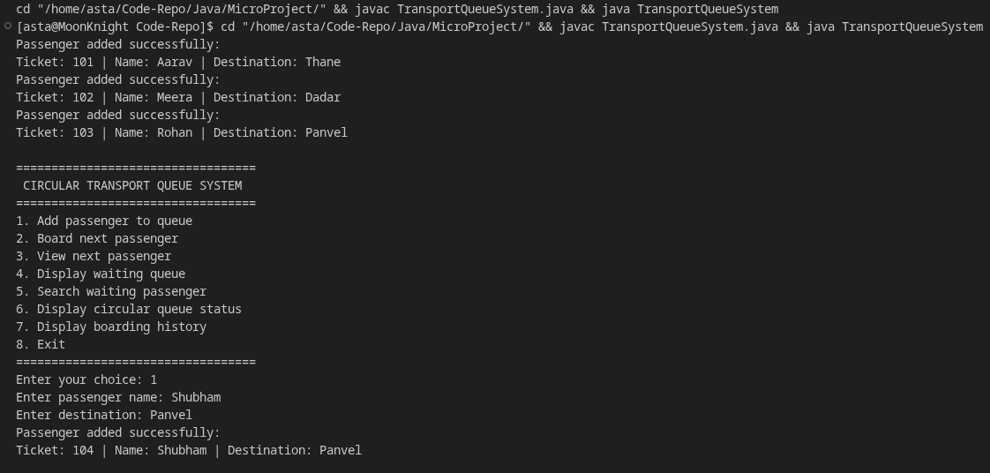
Testing and Complexity
Test | Expected | Result
Enqueue | Passenger added at rear, size +1 | Pending verification
Dequeue | Front boarded, size -1 | Pending verification
Peek | Front shown, no removal | Pending verification
FIFO order | Boarded in arrival order | Pending verification
Search existing | Passenger found | Pending verification
Search missing | Not-found message | Pending verification
Overflow | Add refused at size 5 | Pending verification
Underflow | Board refused at size 0 | Pending verification
Wraparound | Freed slots reused | Pending verification
Invalid menu input | Error, menu repeats | Pending verification
Operation | Time
Enqueue, dequeue, peek | O(1)
Empty / full check | O(1)
Search by ticket | O(n)
Display queue | O(n)
Physical status | O(C)
Queue storage | O(C)
Boarding history | Per actual implementation
n = waiting passengers; C = capacity (5 here).
javac TransportQueueSystem.java
java TransportQueueSystem
Notes:
Member 6: results are marked Pending verification because tests have not been recorded. Run each case, then replace with Pass/Fail and paste a real screenshot. Do not show simulated output. Explain boarding history separately: if stored in a manually managed array, adding is O(1) while capacity lasts and display is O(h) for h records; state exactly what the final code does. VIVA: 1) Why circular? Freed slots are reused, so storage is not wasted. 2) Why modulo? It wraps index 4 back to 0. 3) Full vs empty? size == capacity vs size == 0. 4) Full or empty queue? Overflow or underflow message, no state change. 5) Complexity? Enqueue O(1), dequeue O(1), search O(n).
5

Slide 6
Limitations, Learning and Contributions
Limitations
Learning outcomes
References
  Fixed capacity of 5
  Console-only interface
  In-memory records, no storage
  Simplified ticket generation
  FIFO, modulo, circular indexing
  Overflow, underflow, invariants
  Object-oriented design
  Algorithmic complexity
  Oracle, Java SE Documentation (docs.oracle.com/javase)
  [Prescribed Data Structures textbook]
  VESIT course notes
THANK YOU
VESIT, Mumbai · Data Structures · Circular Queue Transport System · 6/6
Notes:
Fill the contribution table with real names and only verified contributions. SUGGESTED DIVISION (adapt to team size): M1 problem and objectives; M2 data structure and comparison; M3 diagram and enqueue; M4 dequeue, peek, overflow/underflow; M5 dry run; M6 testing, complexity, demo. Each member also answers one viva question. Replace the textbook placeholder with the actual prescribed book.
6

